Slide 1

Social Network Services and Businesses

Slide 2
Social Game

Slide 3
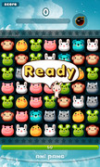

Social Game Fever

Slide 4
Market Situation
Dominant Cacao
2012 Revenue 45 M, Profit 6.5 M
4/4 based projection: 2013 Revenue .45B
PER 20: 1.3 B Asset Value
US Whatsapp based estimation: Google 1B, 1 user 10$ - .85B
Others: NHNLine, TicToc etc..

Slide 5
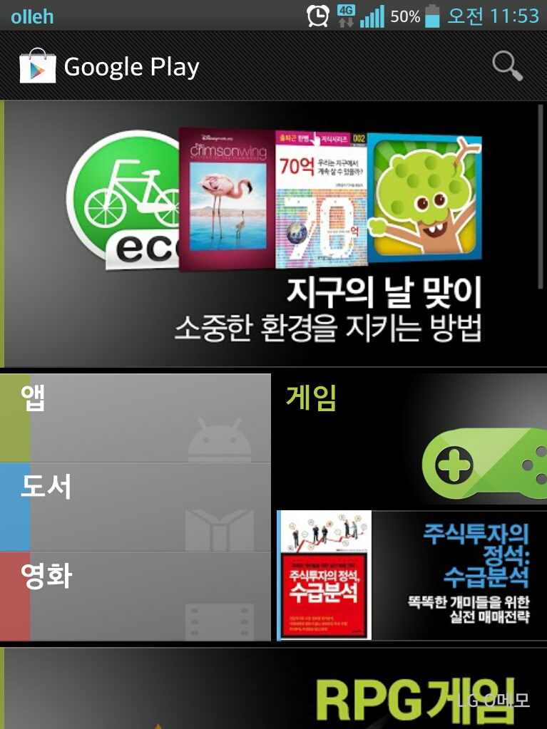
Google Play Market
2012. Nov.: 200M (AppStore+Google Play)
App Store: 5M downloads

Slide 6
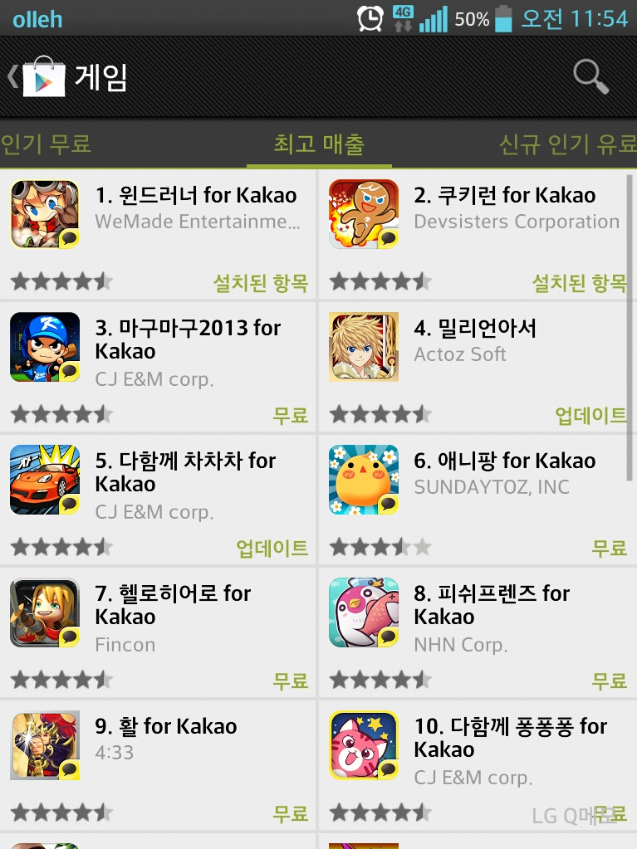
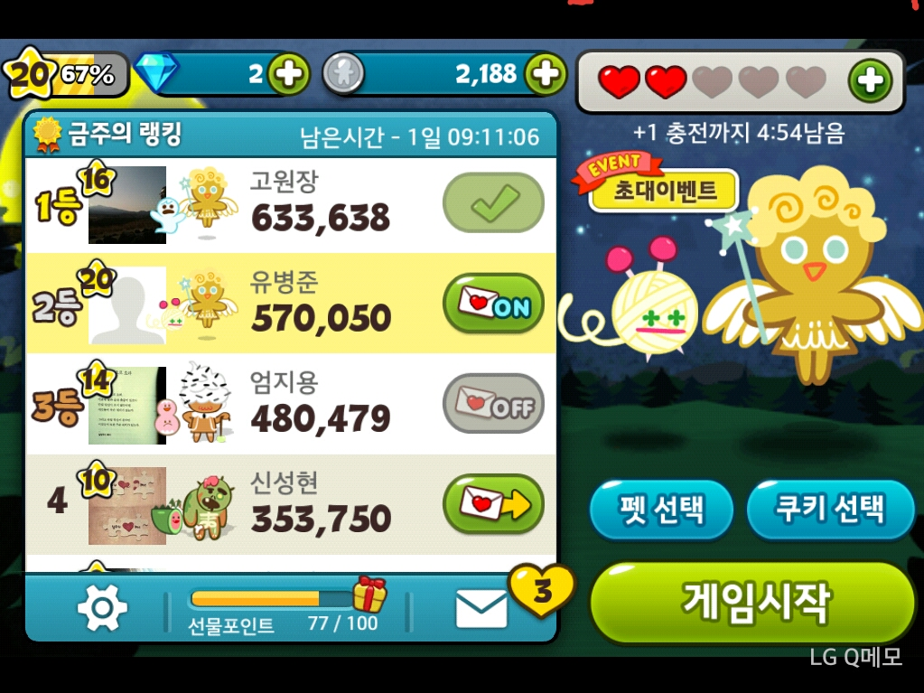
Korean Social Game Market

Slide 7
Analysis
Fun: Simple, Interaction with friends (Free SMS, -AniPang Syndrome), Competition, Ranking
Revenue per game: Google Play 1st, 5th, 20th
Problems:
Consumer: Time waste
Too much commission (30%, 20%)
Company: Life span, good for SME?(Success cases?)
Future: About having fun (material goods, youngsters..)

Slide 8
Social Media Market

Slide 9
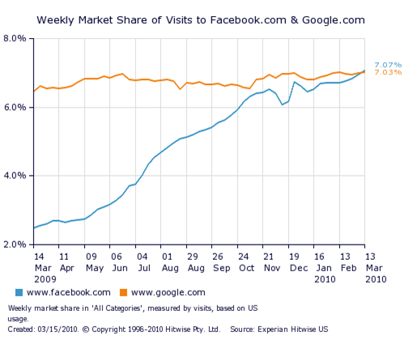



Slide 10
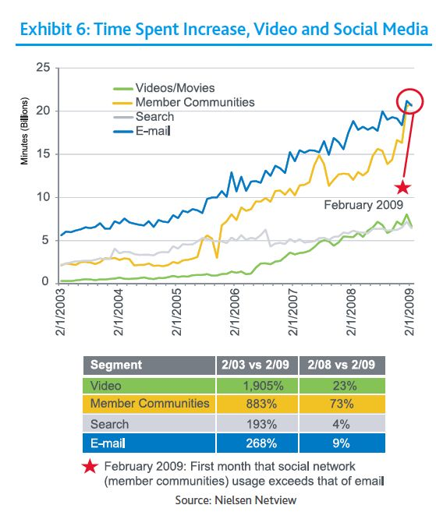

Slide 11
Interesting Statistics on SNS
2010, 96% of youngsters are using SNS
SNS > Porno in search
In US, 1 out of 8 married couples met each other from SNS
Time for 50M Users: Radio (38yr), TV(13yr), Internet(4yr), iPod(3yr), Facebook(9 months)
China’s Qzone: .3 B users
Youngsters don’t use e-mail any more (BU stops email to students in 2009)
.2 B bloggers, 54% very active who use SNS every day
SNS have made ‘word of mouth’ into ‘world of mouth’

Slide 12
Definition
Social Media
Online tools and media platforms to share people’s thoughts, experiences
Social Network
Network among people with multiple relationship and communications
Social Network Service
Digital People’s Network for maintaing people’s relationship – from “Digital Marketing Internet Media : SNS Market report”
A social network service is a social software specially focused on the building and verifying of social networks for whatever purpose. – from “Wikipedia : social network service”
Many social network services are blog hosting services. (MySpace, Facebook, LiveJournal, LinkedIn, Cyworld, Classmates.com, Flickr..)

Slide 13
SNS in the past
Offline networks: Alumni, Regional Group, Family
Wedding – Matching Services
Pen pal business

Slide 14
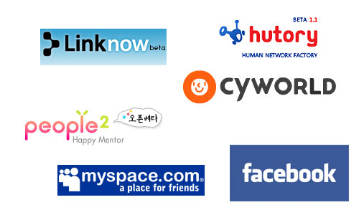
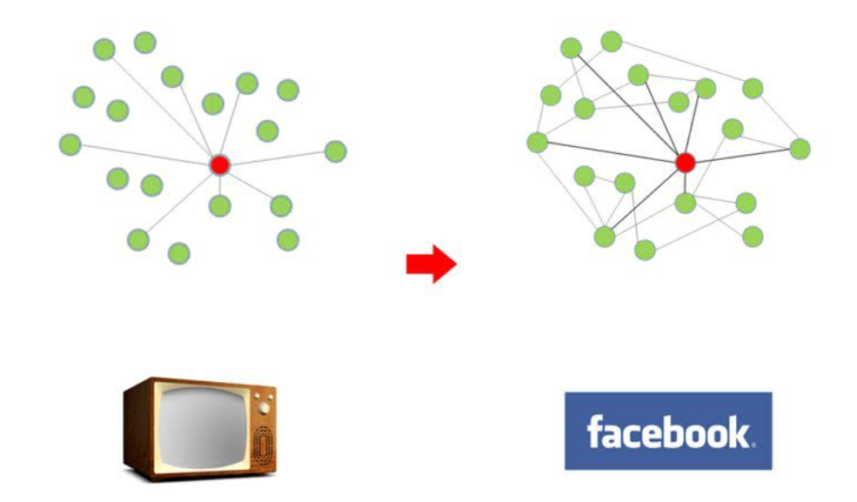
SNS 2.0
After WWW (2000s)
Personal Networks for entertainment or business
More interactive and M-to-M
S N S

Slide 15
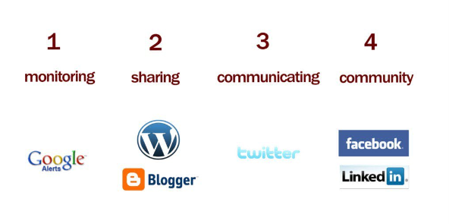
Category

Slide 16
SNS used by Firms

Slide 17
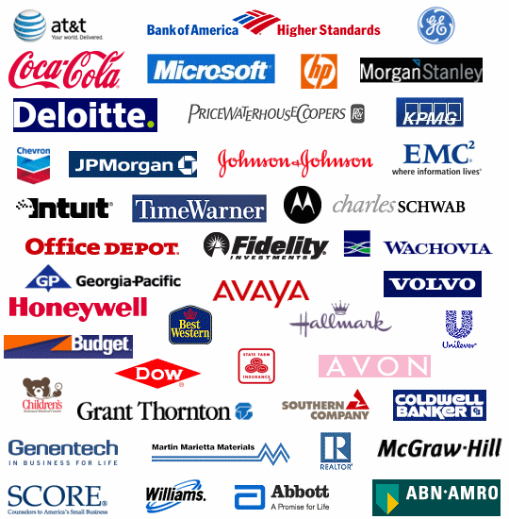
Fortune 100’s SNS

Slide 18
Twitter
Tweet, 2006/3 Odeo Inc.
Simplicity, 140 characters
Real time, media power (quicker)
API (Application Programming Interface)
Accessibility
Mobility!

Slide 19
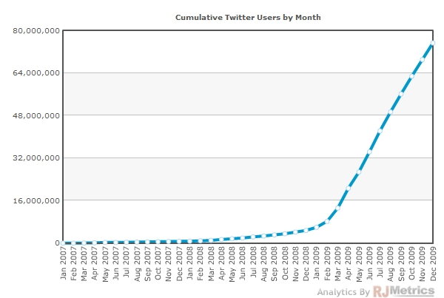
Hockey Stick Business
Friends
Enemies
iphone
release

Slide 20
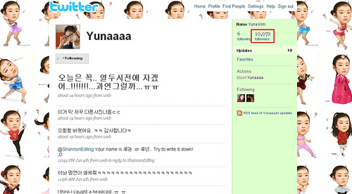
Tweeter Stars - Yuna Kim (.5M) - Lee Woesoo(1.3M) - Prof. Cho Kuk(.3M) - Lady Gaga (32M)
Enemies

Slide 21
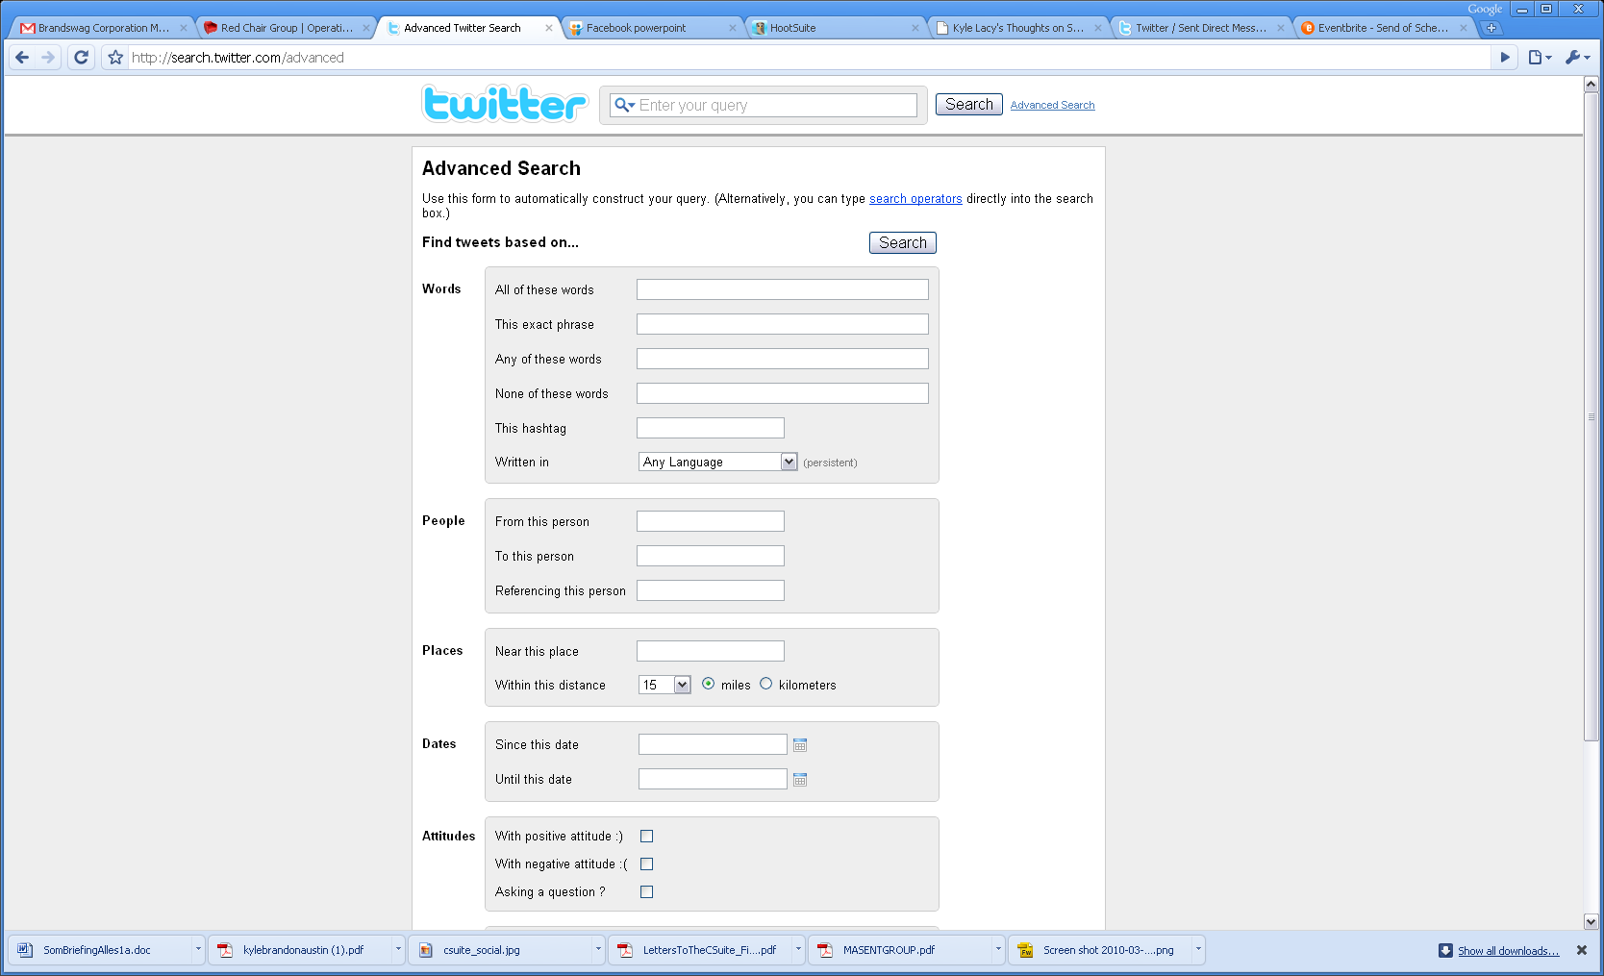
Search

Slide 22
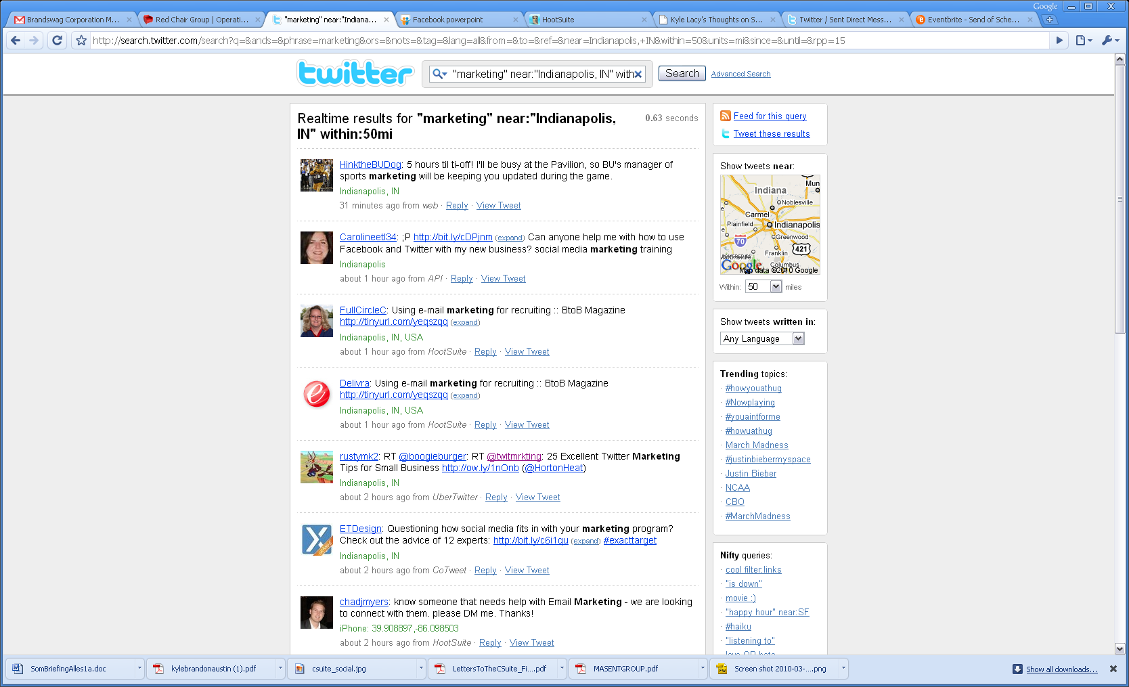

Slide 23
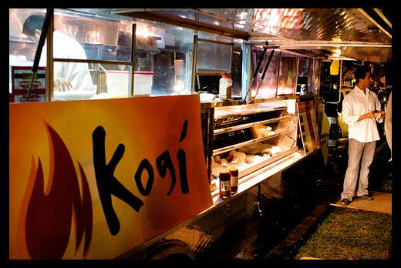
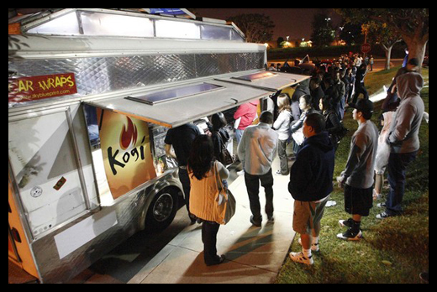
Viral marketing
Kogi Taco
Korean Toco Truck around Hongik Univ. area
Follower : 63,000

Slide 24
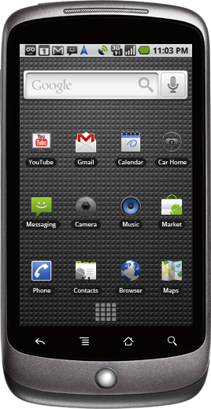
Viral marketing
1 Nexus Phone
Spend only 2 M won (2,000$)
Attracts

Slide 25
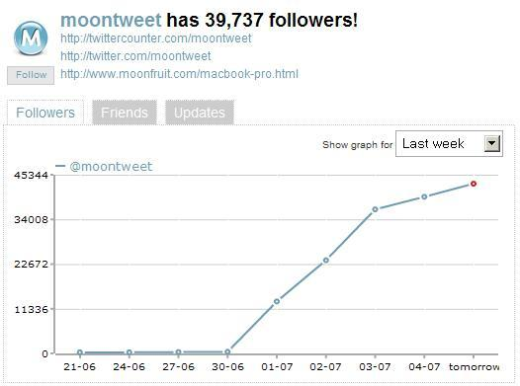
Follower 10% at that time

Slide 26
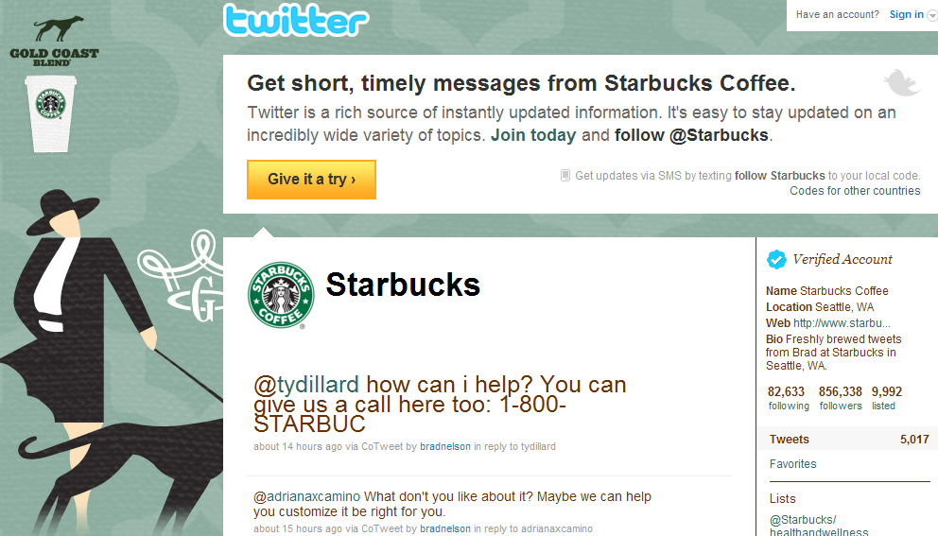

Slide 27
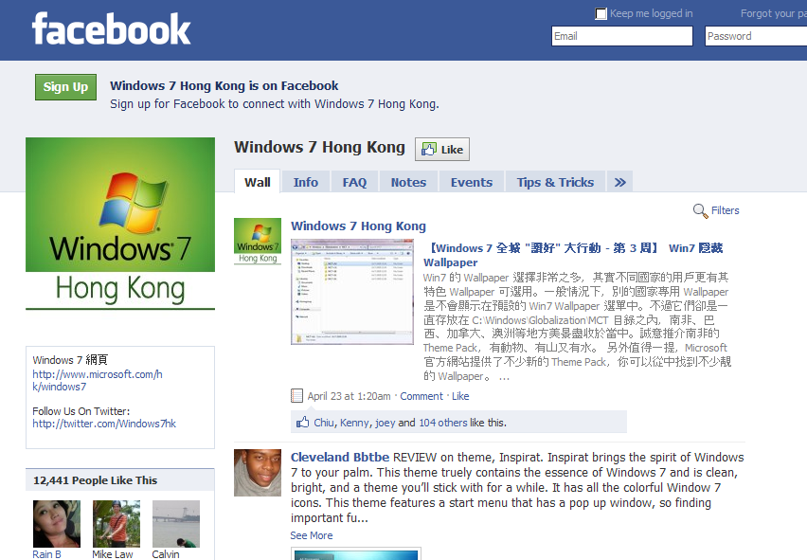

Slide 28
Best practices
Build relationships on Twitter
Listen for comments about you
Respond to comments and queries
Ask questions
Post links to things people would find interesting
Retweet messages you would like to share
Use a friendly, casual tone
Don’t spam people

Slide 29
Best practices
Leverage the real-time nature of Twitter
Ask questions, float ideas, solicit feedback – and expect fast feedback most of the time
If you’ve launched a product, new store or new campaign, search Twitter for comments
Respond to customer service issues quickly
Engage in discussion on a tricky public issue your company is dealing with

Slide 30
Best practices
Measure the value of Twitter
Before setting up measurement tools, focus on the quality of your engagement: do a gut-check of how things are going
Try to analyze the quality of feedback and topics of discussion, you may find this changing over time
Keep a tally of questions answered, customer problems resolved and positive exchanges held
When offering deals on Twitter, use a unique coupon code or separate landing page

Slide 31

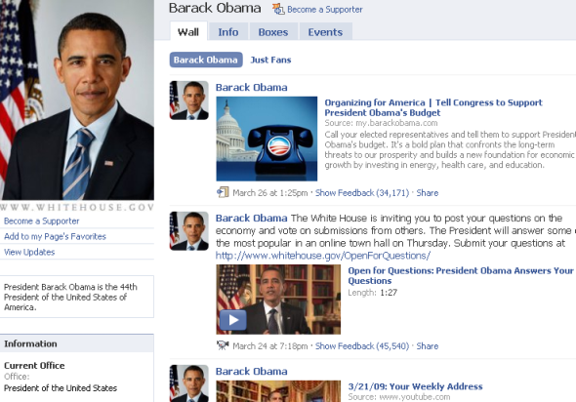

Slide 32
Facebook
Facebook is a social utility that connects people with friends and others who work, study and live around them
Founder: Michael Zuckerberg, 2004
.4 B Users (Global), .1 B Active Users (US)
Characteristics
Platform enables anyone to build complete application
A regional network – school, work, nation
Privacy settings
Open library for developers

Slide 33
Facebook
Facebook is composed of
Profile
User context (ex. At work, at party, at home…)
Interest: Music, TV show, Movies, Books
Basic Information: Profile photo, email, mobile, address, city, country, website, sex, relationship status, looking for, hometown, political view, religious view
Education and work: Education info (schools), work info (employer, position, time period, location)
The wall: messages from friends
Friends
Friends List: send message, Poke, View friends, remove
Find friends: by email contact lists, by instant messenger, Outlook
Status updates: keep up to date with what your friends are doing
Online Now, recently updated, recently added, all friends, invite friends

Slide 34
Facebook
Facebook is composed of
Network
Join the network
Network info: members, friends, type – regional
People in my network: top six people, search and browse (sort)
Upcoming events: today’s 5 events
Marketplace: list something
Discussion board: topic lists
The wall: posts
Applications
Photos: album, image tagging (tagged friends)
Group: create group, joined group, updated group
Marketplace: for sale, housing, jobs…, sponsored listing
Posted items: post a link (videos, songs, …)
Notes: notes about you (tagged by any notes), write notes from mobile, imports an external blogs, popular notes (add comments)
More applications: chat, utility…

Slide 35
SNS Future trends

Slide 36
Changes
SMART Phones! (General Purpose Machines)
Paid Contents Era (with iPad and Table PC)
Convergence of Contents and Services (Music song vs. services)
LBS, Augmented Reality, Social – 3 Killer platforms and their combinations
Facebook -> Web OS
Twitter -> Realtime Framework
AR / LBS Services (including advertising)

Slide 37
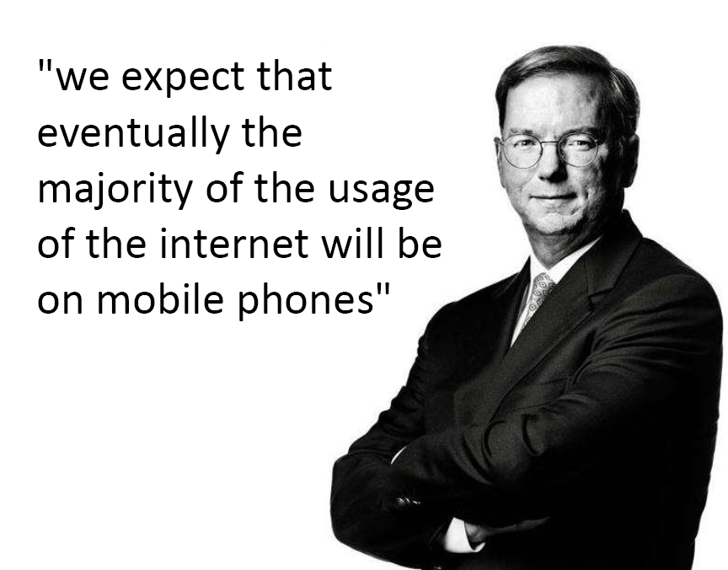

Slide 38
Conclusion

Slide 39
Social Media Related Strategy
Listening – seeking customer insights for use in marketing and development
Talking – expanding your efforts to more interactive channels
Energizing – finding your most enthusiastic customers and supercharging their word of mouth
Supporting – helping your customers support each other
Embracing – integrating your customers’ feedback

Slide 40
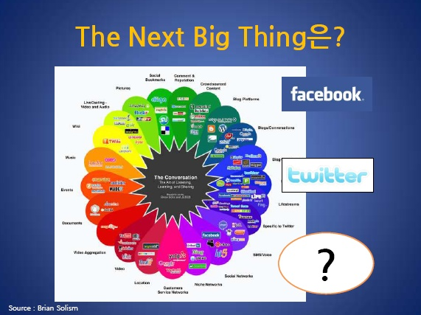

Slide 41
Korean SNS & Future
Stopped, Obsolete
Skepticism: HW centered culture, SW vs. Korean culture (Speed vs. Time consumption)
Optimism: Korean’s Networked Society, Quick adoption
Direction: Entertainment?

